Slide 1
Introducing In Our Place
Bradford District’s online place for families’ and people’s emotional wellbeing

Slide 2
A free, online library of evidence-based courses to help people in the Bradford District deal with…
Child ages and stages
Family life
Pregnancy and a new baby
Parenting
Relationships
Children’s feelings and mental health
Children with additional needs
Emotional wellbeing

Slide 3
Free and universally available
For families, teens and adults across the Bradford District
Complement and enhance (but not replace) existing support and programmes
Provided by:
Courses developed by:
Find it on:

Slide 4
Courses overview
17 courses, themed for different age groups and needs
Antenatal
Understanding pregnancy, labour, birth and your baby.
Understanding pregnancy, labour, birth and your baby: for women couples.
Postnatal (0 - 6 months)
Understanding your baby
Understanding your preterm or sick baby in hospital
Understanding your preterm or sick baby now you're home
Children and Young People (6 months to 19+ years)
Understanding your child: from toddler to teenager
Understanding your child with additional needs
Understanding your child's feelings
Understanding your child's mental health and wellbeing
Understanding the impact of the pandemic on your child
Preteen to teenager
Understanding your teenager's brain
Moving up to secondary school for children with additional needs
Understanding the impact of the pandemic on your teenager
For Teenagers
Understanding your brain (for teenagers only!)
Understanding your feelings (for teenagers only!)
For Adults
Understanding your relationships
Understanding your own trauma

Slide 5
Access online
Available online, on-demand
Courses delivered through a combination of audio, video and text
Short modules to fit easily around family life
Follow in your own time and at your own pace
Ideal for people with a device such as a smart phone, tablet or PC
Support is available via the Bradford District’s Family Hubs for people for whom digital access is a challenge

Slide 6
Language options
Some In Our Place courses are available translated into languages including Modern Standard Arabic, Polish and Urdu
The full library supports auto-translation through Google Translate, which offers over 200 languages

Slide 7
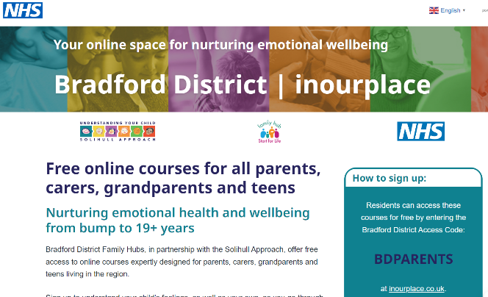
Find In Our Place online
fyi.bradford.gov.uk/ parenting-programme-pathway

Slide 8
Using the In Our Place course library
All the In Our Place courses are completely free for Bradford District residents.
People can register for as many courses as they want.
To access the courses for free, all people will need is their post code and the access code – BDPARENTS
FREE!
With access code BDPARENTS
inourplace.co.uk/bradford

Slide 9
Promoting In Our Place to families
Ongoing marketing campaign targeting families, workforce and partners.
You can signpost In Our Place to families seeking support, if appropriate for their needs.
Practitioners also encouraged to use the courses during one-to-one support with parents, if they are unable to access a group programme and/or require support to access the course digitally.

Slide 10
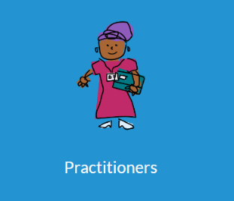
Further information – FYI Practitioners
fyi.bradford.gov.uk/practitioners/ start-for-life-offer/ in-our-place-information-for-practitioners/

Slide 11
Further information – watch a video
Introduction for professionals from the providers
The In Our Place course library has been developed by Solihull Approach, a not-for-profit NHS service.
In Our Place is the brand name for the ‘MUL’ (multi-user licence) course library available in the Bradford District.
Watch the explainer video on YouTube – background information about Solihull Approach comes first; the section about In Our Place is from 6 minutes 45 seconds onwards.
https://youtu.be/b2JLdAEnEwA
While the course library is provided by Solihull Approach, please always call the offer ‘In Our Place’. This is more family friendly, and this is what is recommended by Solihull Approach themselves.

Slide 12
Further information – Any questions?
Please email:
Eve Remington - eve.remington@bradfordcft.org.uk
Emma Richardson - emma.richardson@bradford.gov.uk.

