Slide 1



Helping parents find
their pathway to better
emotional health.

Slide 2





Universally available for families, teens, and adults across Bradford, designed to complement and enhance without replacing existing support and programmes.
Courses
developed by:
Find
Togetherness via:
Provided by:
fyi.bradford.gov.uk/parenting-programme-pathway

Slide 3
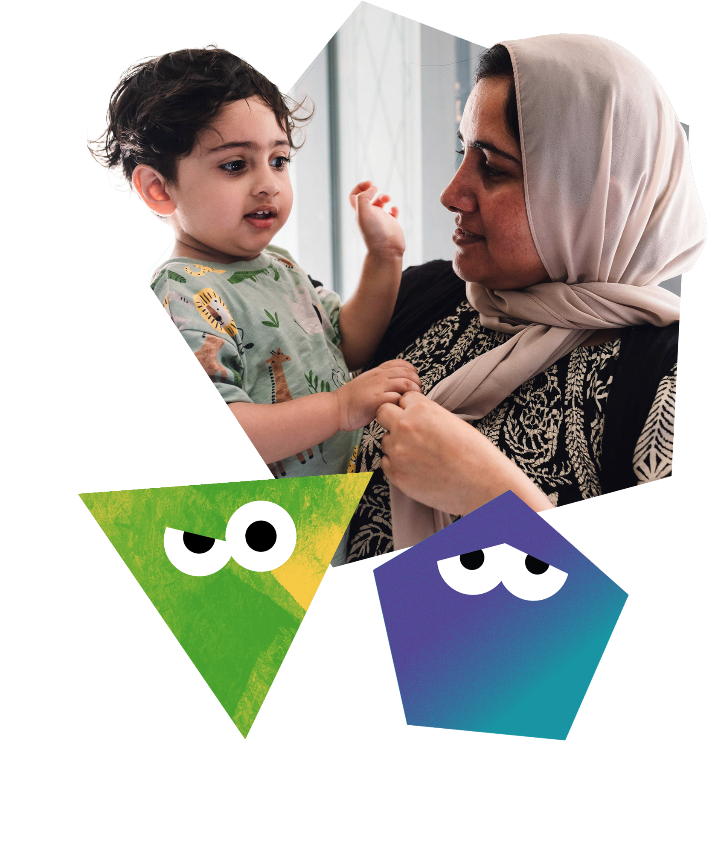
A free, online library of evidence-based courses to help people in the Bradford District deal with…
Pregnancy and a new baby
Family life
Child ages and stages
Parenting
Children’s feelings and mental health
Children with additional needs
Relationships
Emotional wellbeing

Slide 4
Courses overview
19 courses themed for different age groups & needs.
Antenatal
Understanding pregnancy, labour, birth and your baby.
Understanding pregnancy, labour, birth and your baby: for women couples.
Postnatal (0 - 6 mths)
Understanding your baby
Understanding your preterm or sick baby in hospital
Understanding your preterm or sick baby now you are home
Children & Young People (6mths to 19+ yrs)
Understanding your child: from toddler to teenager
Understanding your child with additional needs
Understanding your child's feelings
Understanding your child's mental health and wellbeing
Understanding the impact of the pandemic on your child
Understanding your child in a changing world
Understanding your deaf child for hearing parents
Preteen to teenager
Understanding your teenager's brain
Moving up to secondary school for children with additional needs
Understanding the impact of the pandemic on your teenager
For Teenagers Only
Understanding your brain
Understanding your feelings
For Adults
Understanding your relationships
Understanding your own trauma

Slide 5







Access online
Online and on-demand
Mix of audio, video, and text
Short modules that fit around family life
Learn anytime, at your own pace
Works on smartphones, tablets, or PCs
Help at Family Hubs for those without digital access

Slide 6
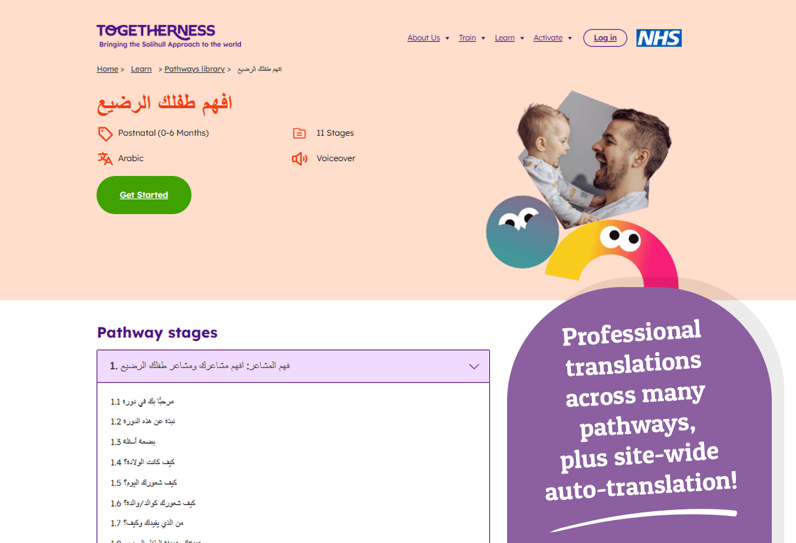
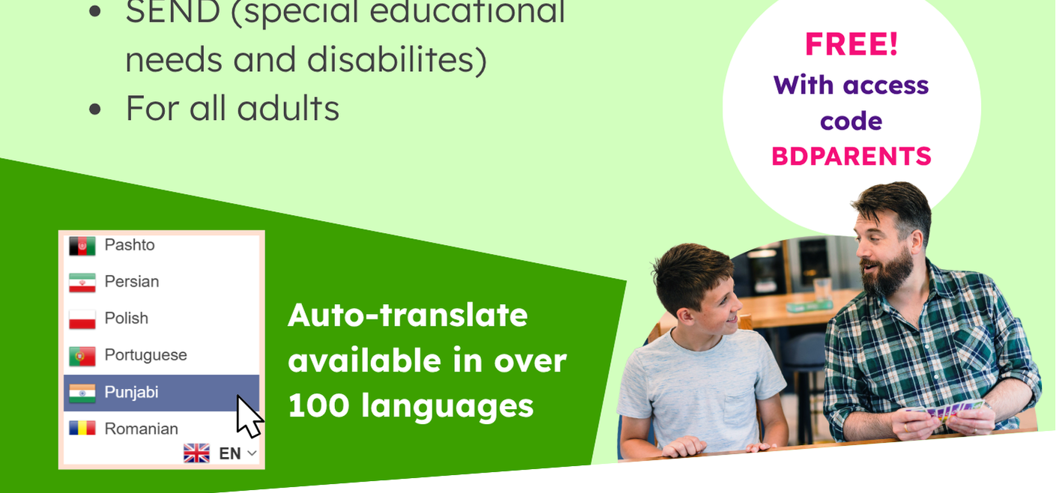

Language options - togetherness.co.uk/pathway-library/
Some courses are available translated into languages including Modern Standard Arabic, Polish, Urdu, and various other languages.
The full library supports auto-translation through Google Translate, which offers over 200 languages.

Slide 7
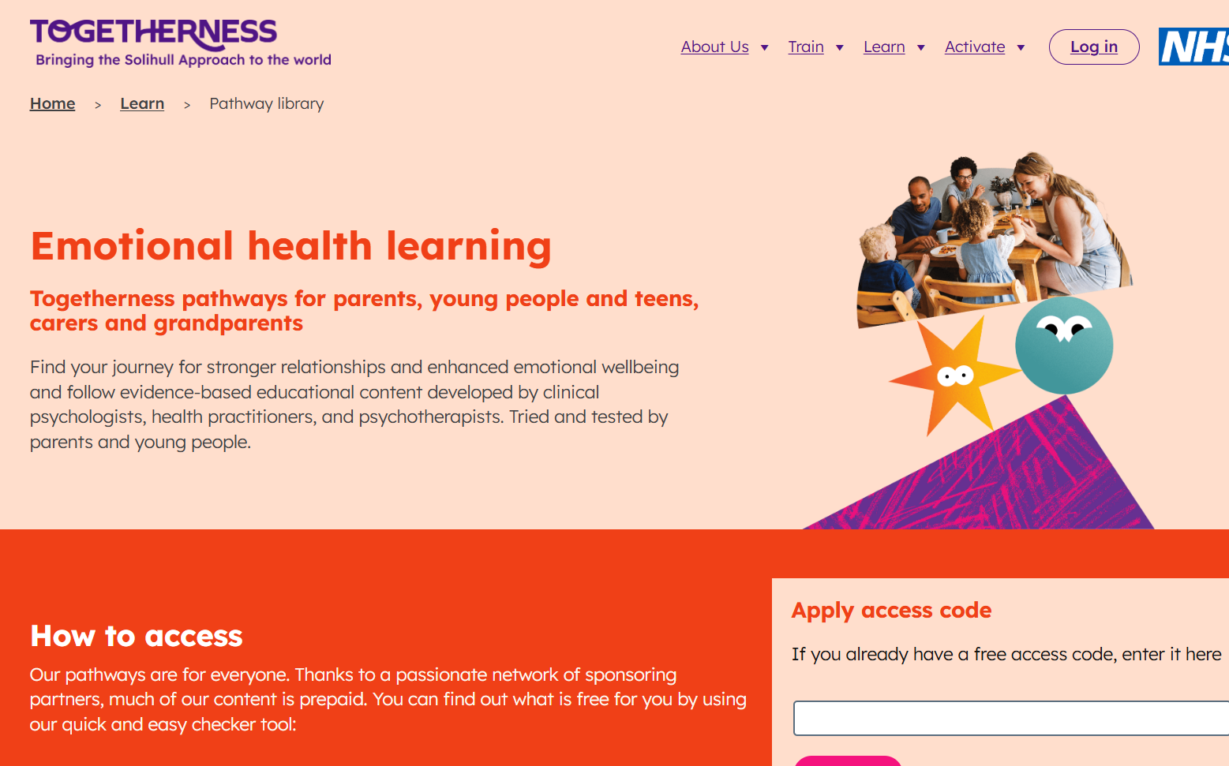
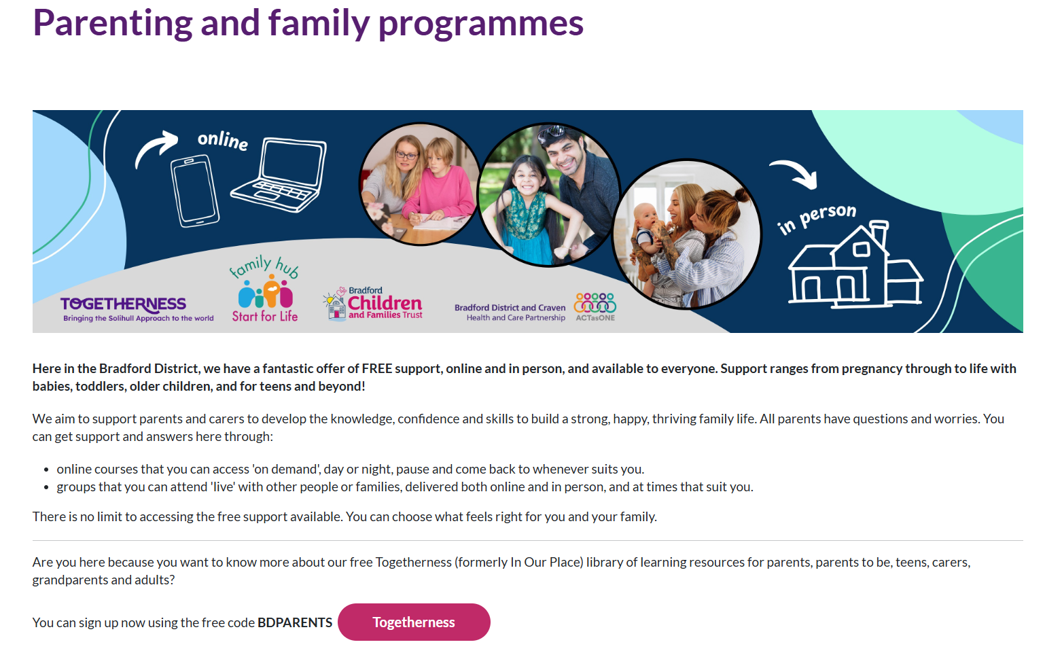
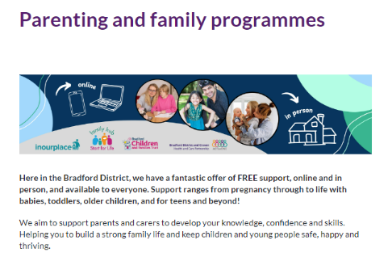
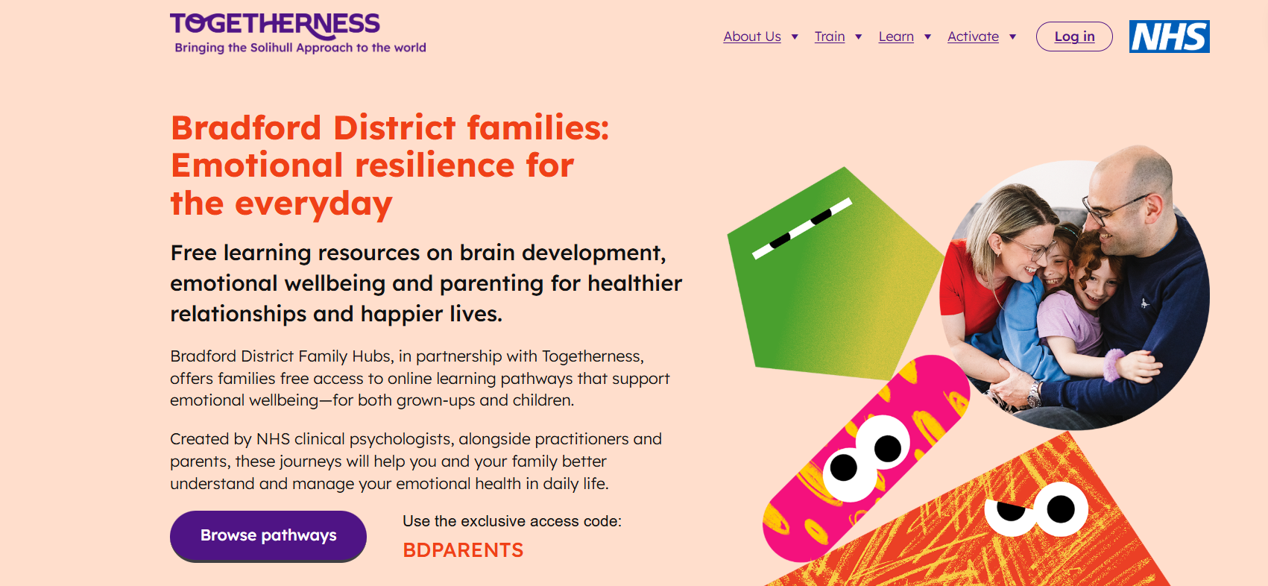

Find Togetherness online togetherness.co.uk
fyi.bradford.gov.uk/parenting-programme-pathway

Slide 8
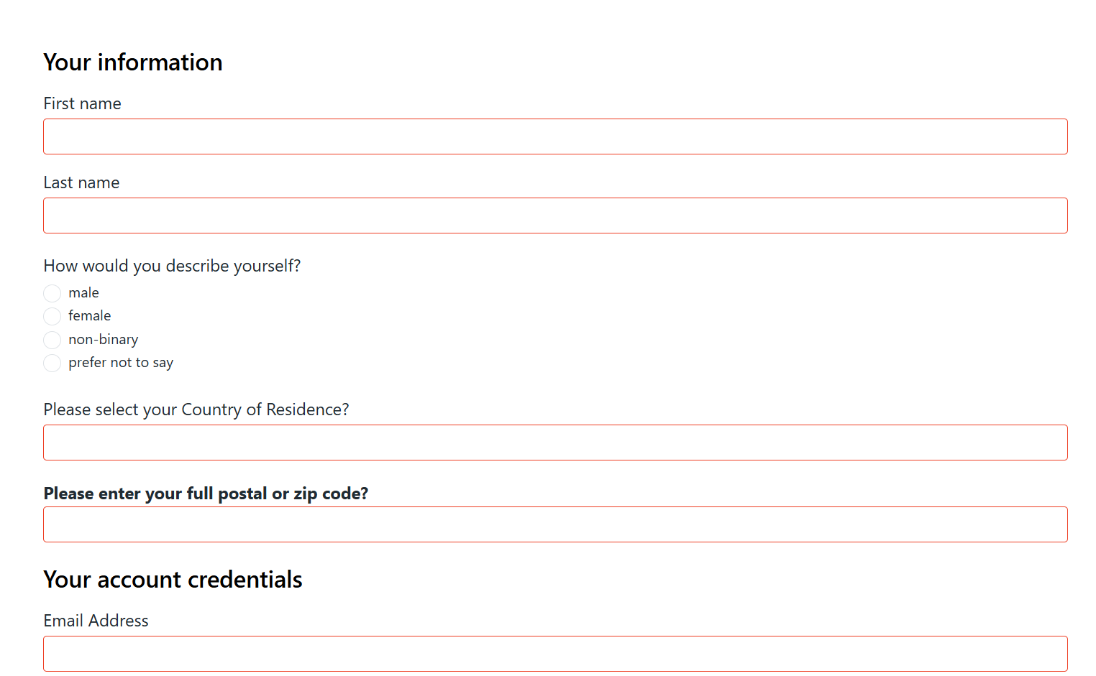
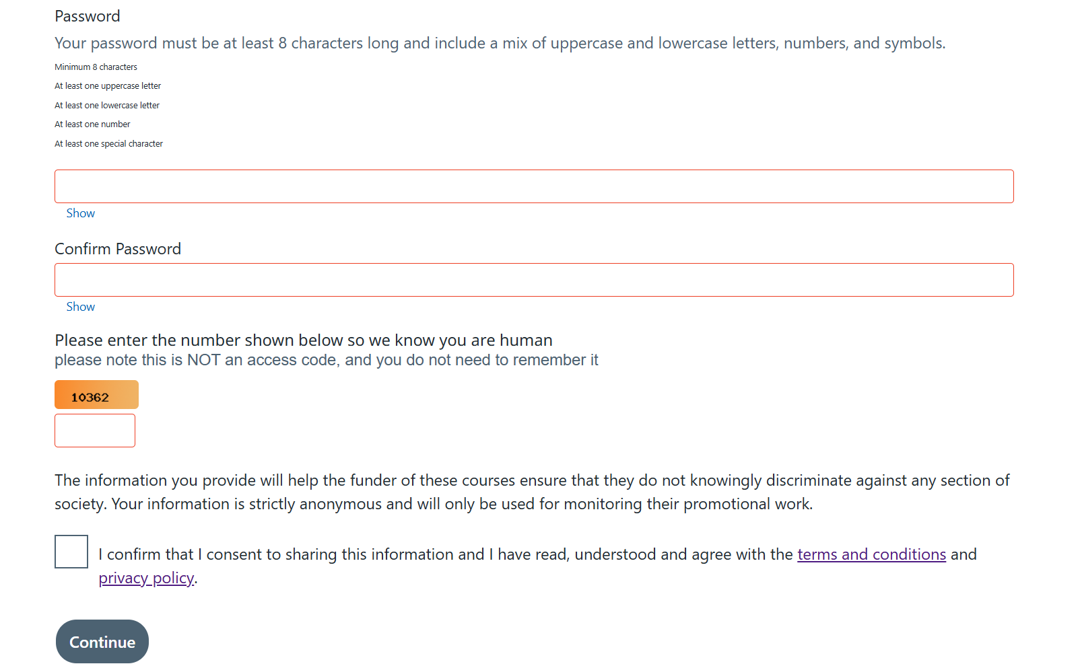

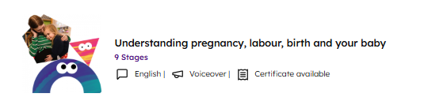
Signing Up
Sign up to the courses are anonymous
Certificates are available for certain courses

Slide 9
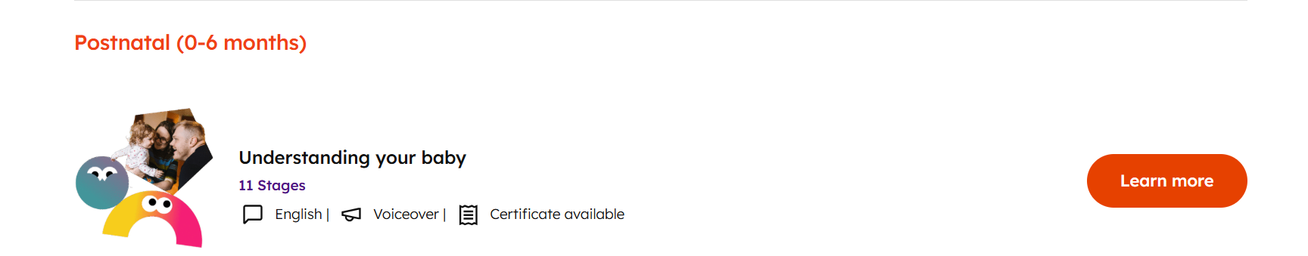
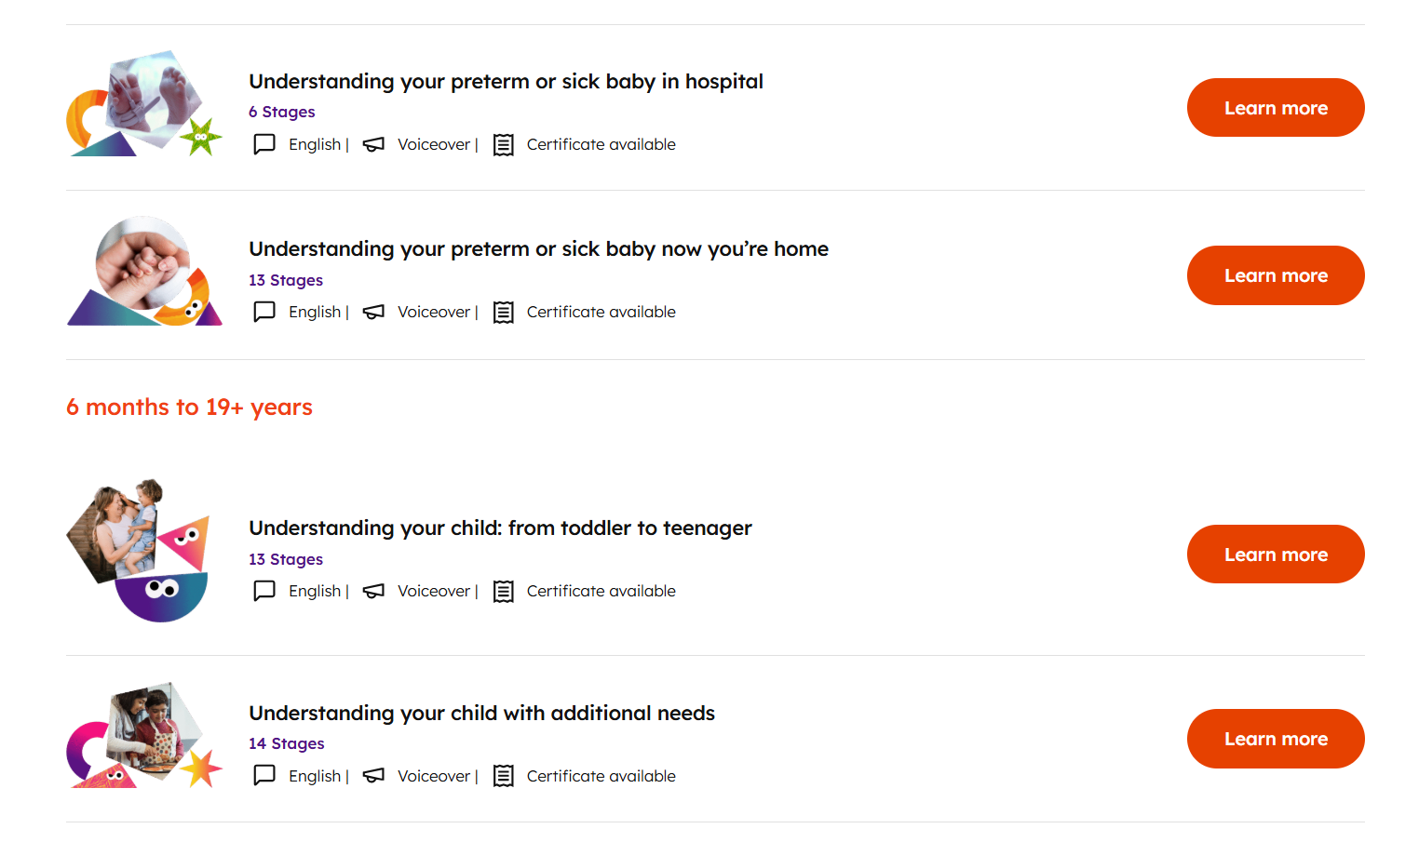
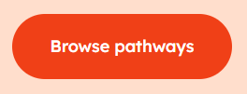
Using the Togetherness course library
To access the courses for free, all people will need is their post code and the access code – BDPARENTS
People can register for as many courses as they want.
FREE!
With access code: BDPARENTS

Slide 10

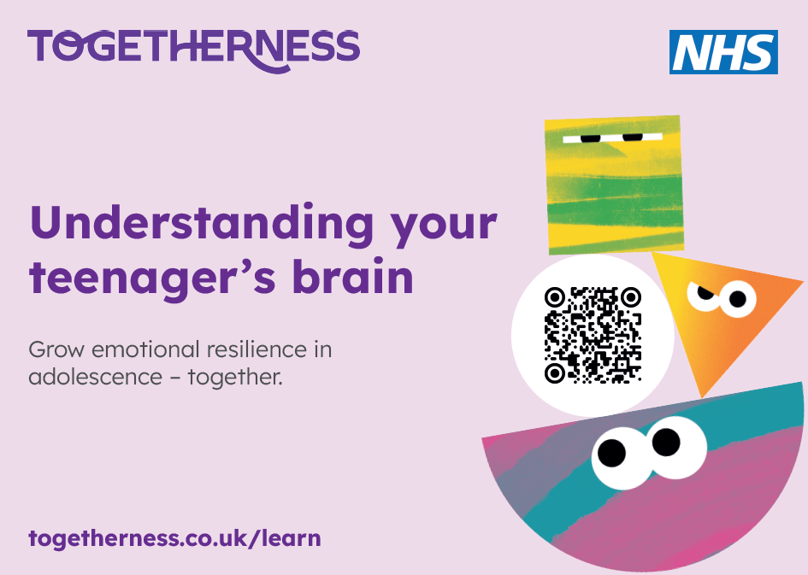
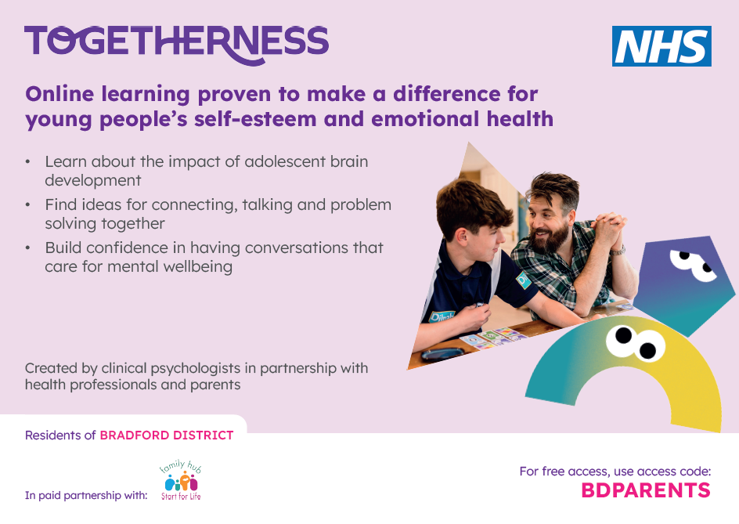
Promoting Togetherness to families
Ongoing marketing campaign targeting families, workforce and partners.
You can connect to families seeking support, if appropriate for their needs.
Practitioners also encouraged to use the courses during one-to-one support with parents, if they are unable to access a group programme and/or require support to access the course digitally.

Slide 11
Targeted approaches
Primary schools
Understanding your child: from toddler to teenager
Understanding your child's feelings
Understanding your child's mental health and wellbeing
Understanding the impact of the pandemic on your child
Understanding your child with additional needs
Moving up to secondary school for children with additional needs
Understanding your child in a changing world
Secondary schools
Understanding your teenager's brain
Understanding the impact of the pandemic on your teenager
Understanding your brain (for teens only!)
Understanding your feelings (for teens only!)
Moving up to secondary school for children with additional needs
Understanding your child in a changing world
Neonatal / intensive care
Understanding your preterm or sick baby in hospital
Understanding your preterm or sick baby now you are home
SEND
Understanding your child with additional needs
Moving up to secondary school for children with additional needs
Understanding your child's feelings
Understanding your child's mental health and wellbeing
Understanding the impact of the pandemic on your child/teenager
Understanding your deaf child for hearing parents
LGBTQ+
Understanding pregnancy, labour, birth and baby: for women couples.

Slide 12

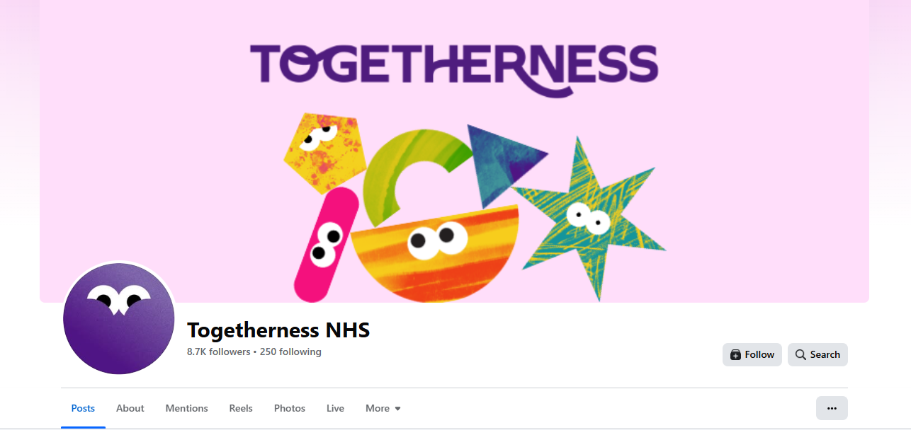
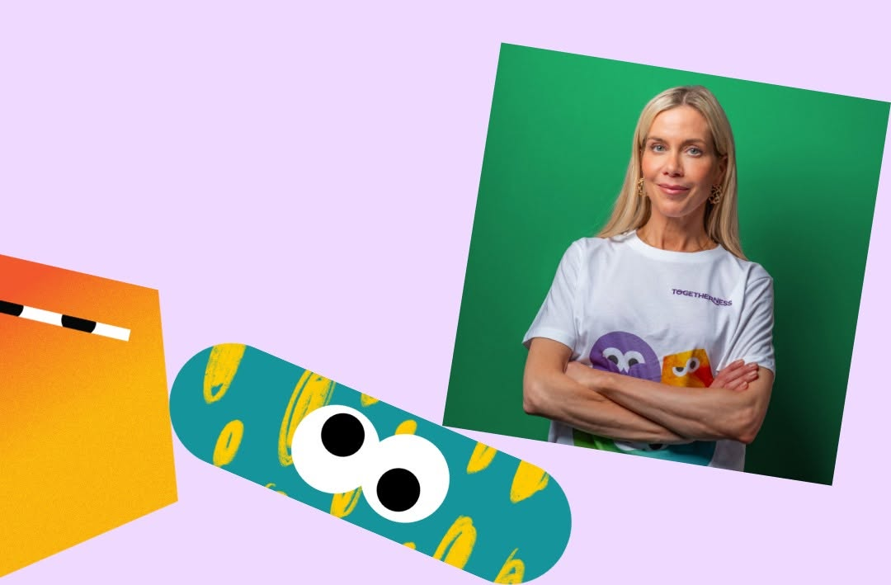
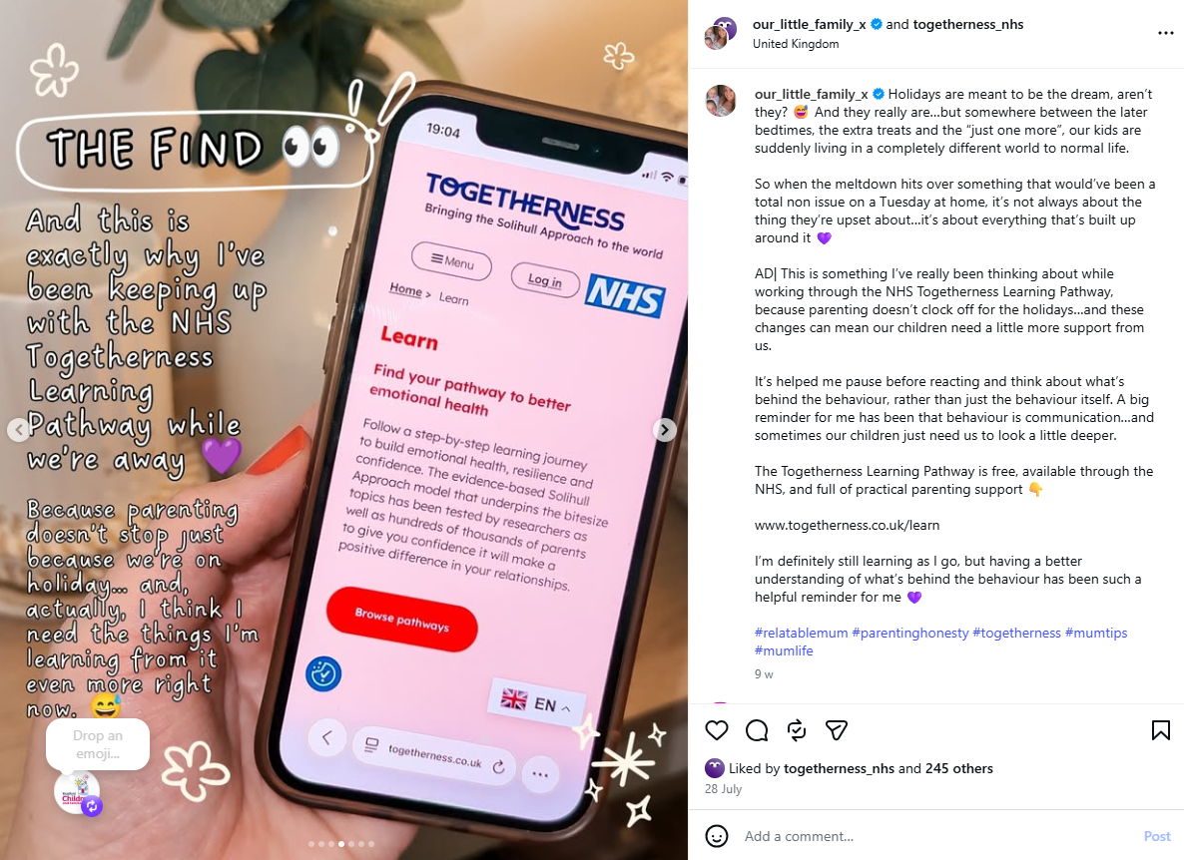
Find Togetherness NHS on:
Working with influencers and micro influencers to support promotion and publicity.
  Kate Lawler - Brand Ambassador
  Instagram micro influencer - our_little_family_x

Slide 13

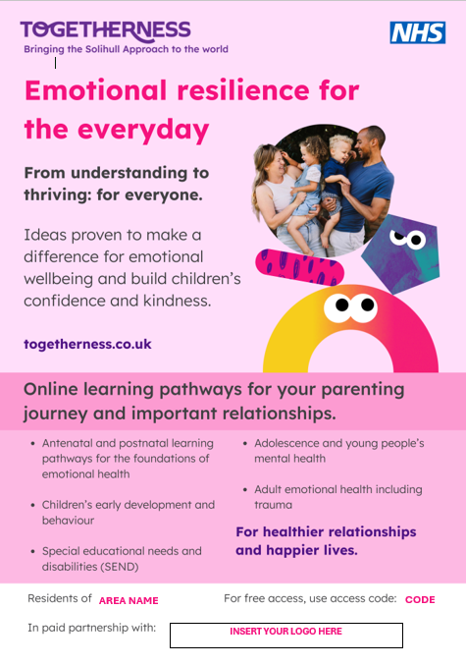
Toolkit Available
A toolkit is available on FYI which includes:
Downloadable, printable posters x2
Downloadable flyer - double sided (added soon)
Text content for newsletters, social media and internal communications
Images for use on social media etc
This PowerPoint slide pack
Digital screens
Toolkit
*Printed copies of some resources are available on request, subject to availability.

Slide 14
Any Questions?
Please email:
Eve Remington - eve.remington@bradfordcft.org.uk
Emma Richardson - emma.richardson@bradfordcft.org.uk

